Slide 1
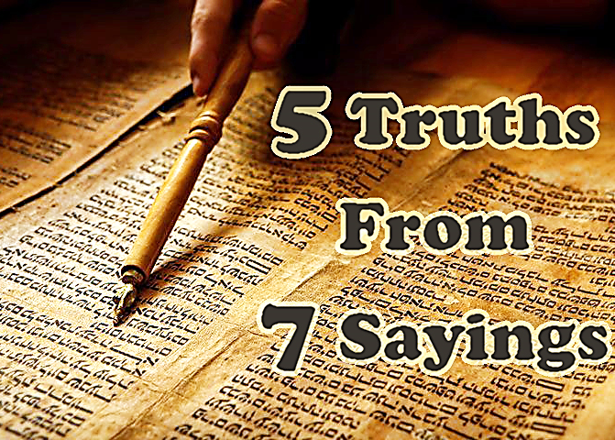

Slide 2



Note: After you download the slideshow, you may also need to download some videos from YouTube & add them into this PowerPoint. This tool can help you:
Free YouTube Download
We present these messages in outdoor venues using the SonShineTent.
Watch the video of our service that goes with this message, click here: http://campaignkerusso.org/?p=16326
We would love to know more about the people who download our lessons & sermons. We invite you to email us & let us know where & how you use them.
info@campaignkerusso.org

Slide 3

Let’s Begin with Prayer

Slide 5
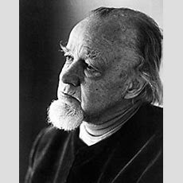
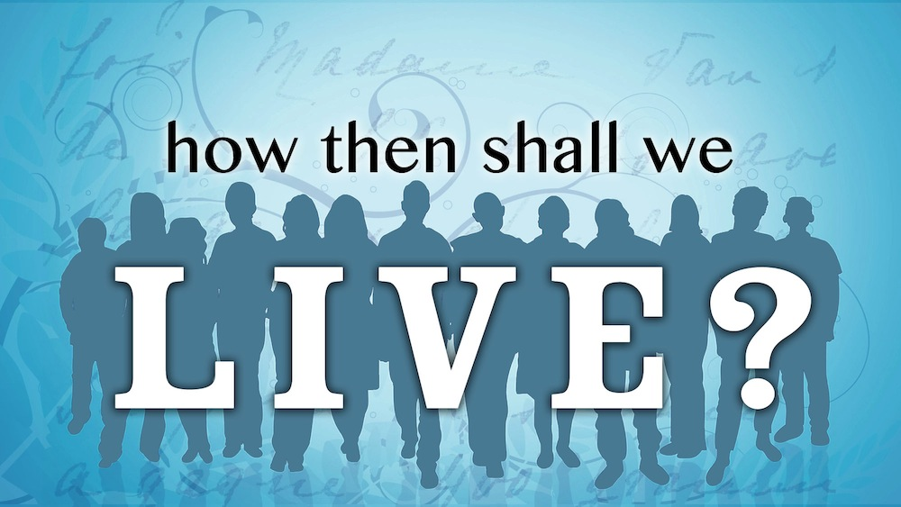
Francis A. Schaeffer asked an enduring question in his famous book…

Slide 6
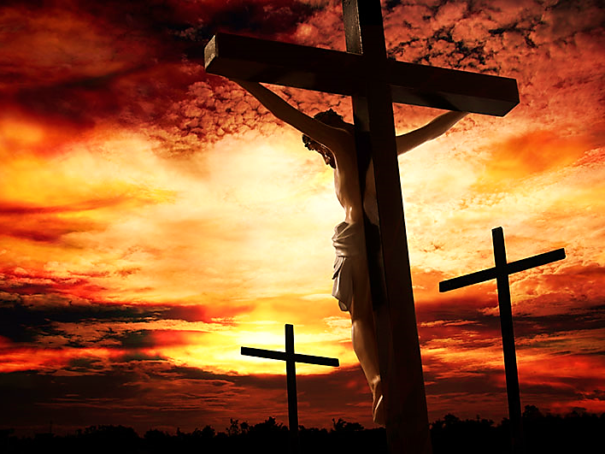
In the six hours that Jesus hung, dying on the cross, He uttered 7 famous sayings.
With the completion of these words, He fulfilled key Messianic prophecies and wrought the grueling task He came to Earth to do.
.

Slide 7
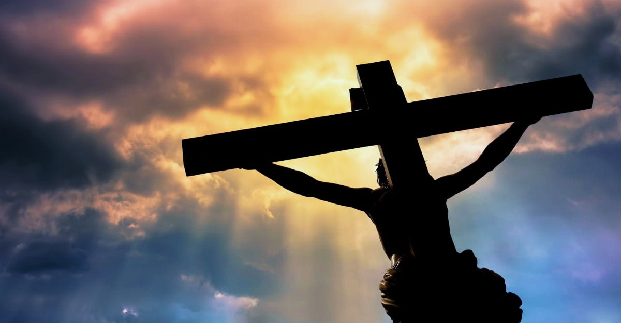
He bought and secured our salvation with His own suffering, death & blood shed for our sin.
With these seven sayings, in six agonizing hours, He showed us what was on His heart and mind as He was dying.

Slide 8

As He was in life, so He was in death.
In these 7 short sayings, He encapsulated who He is and in doing so, gave us the blueprint of how we should live.

Slide 9
We will look at 5 great truths for us to emulate.

Slide 10
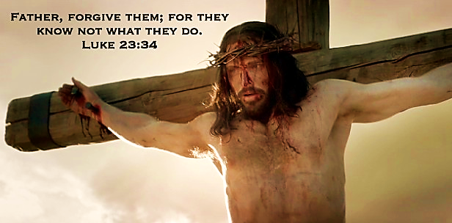
Truth #1 - Jesus had a Great Burden for Souls
First and foremost, Jesus is thinking about the souls of men and their eternal standing with the Father. This was His life’s work and His heart.

Slide 11
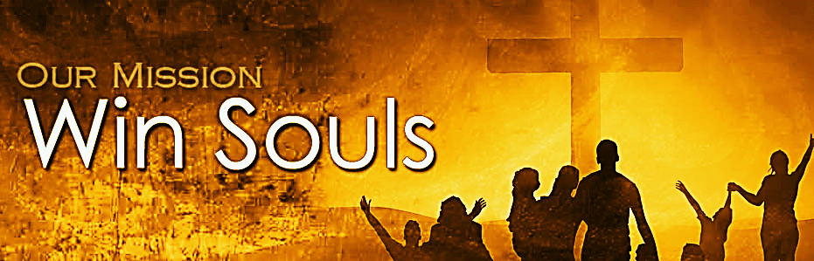
It is how we should live.
“For I take no special pride in the fact that I preach the Gospel. I feel compelled to do so; I should be utterly miserable if I failed to preach it.” 1 Cor. 9:16 (Phillips)
“Sometimes I tell myself not to think about you, Lord, or even mention your name. But your message burns in my heart and bones, and I cannot keep silent.” Jer. 20:9 (CEV)

Slide 12
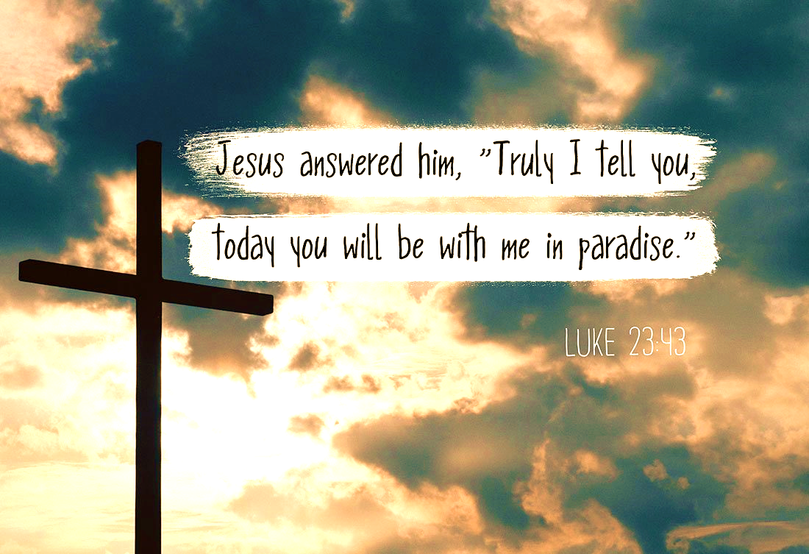
You can almost hear the heartbeat of Jesus saying, “Just one more soul before I die!”
He didn’t say, “Not now, can’t you see I’m suffering here… I’ve got my own problems.”
He rejoiced with the new believer.

Slide 13
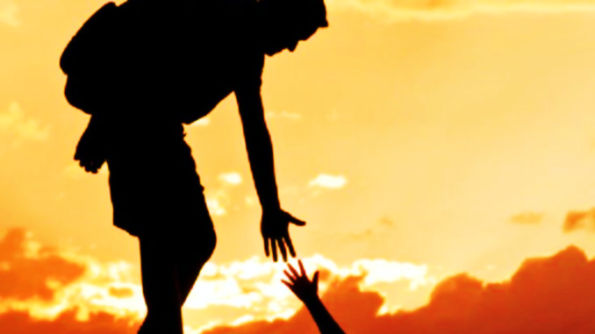
Let’s go out one more time.
Let’s reach out for one more soul.
“May we never tire of doing what is good and right before our Lord because in His season we shall bring in a great harvest if we can just persist.” Gal. 6:9 (VOICE)
“God has been kind enough to trust us with this work. That’s why we never give up.” 2 Cor. 4:1 (CEV)

Slide 14
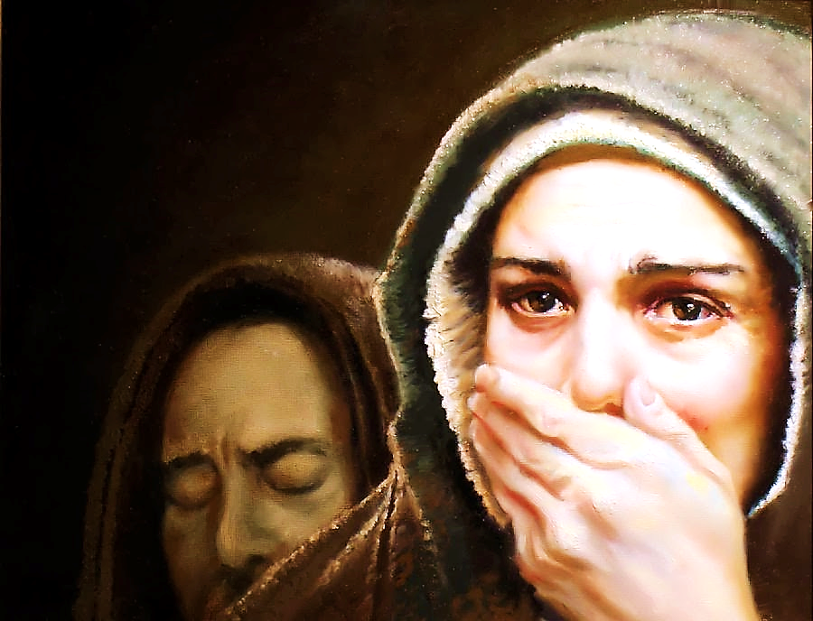
Truth # 2 - Jesus honored His Responsibilities
“Woman, behold your son. Son, behold your mother.” Jn. 19:26, 27
With this, he made sure His youngest disciple and His aging mother would be cared for..

Slide 15

We too, need to honor our responsibilities.
“But if someone does not provide for his own, especially his own family, he has denied the faith and is worse than an unbeliever.” 1 Tim. 5:8 (NET)

Slide 16

“He that is faithful with little is faithful also with much, and he that is unjust with little is unjust also with much.” LK. 16:10 (JUB)

Slide 17
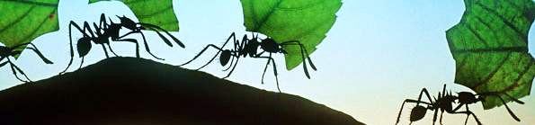
“You lazy fool, look at an ant. Watch it closely; let it teach you a thing or two. Nobody has to tell it what to do. All summer it stores up food; at harvest it stockpiles provisions. So how long are you going to laze around doing nothing? How long before you get out of bed? A nap here, a nap there, a day off here, a day off there, sit back, take it easy—do you know what comes next? Just this: You can look forward to a dirt-poor life…” Pv. 6:6-11 (MSG)

Slide 18
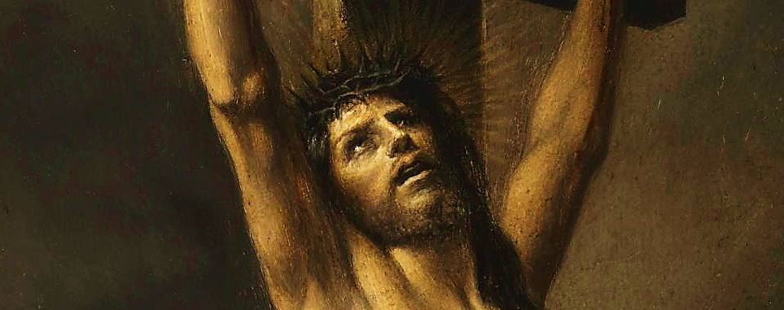

Truth # 3 - Jesus Yearned for Nearness to God

Slide 19
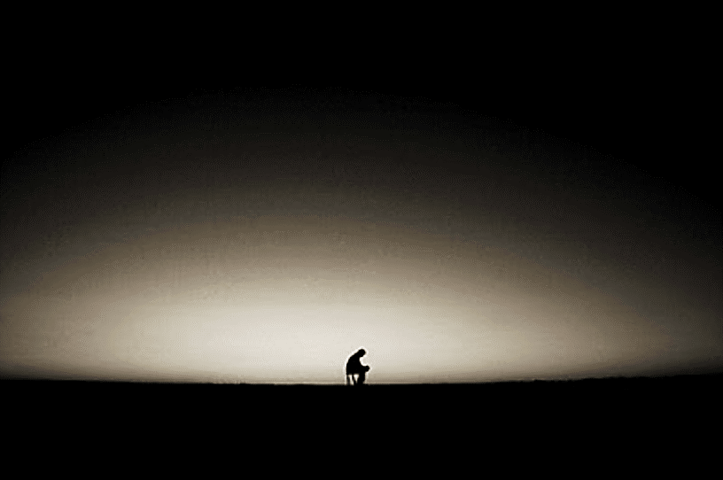
The Greek word for “forsaken” means “Left Alone.”
Although Jesus was one with the Father, in some palpable sense, He felt left alone for the first time in eternal history.

Slide 20
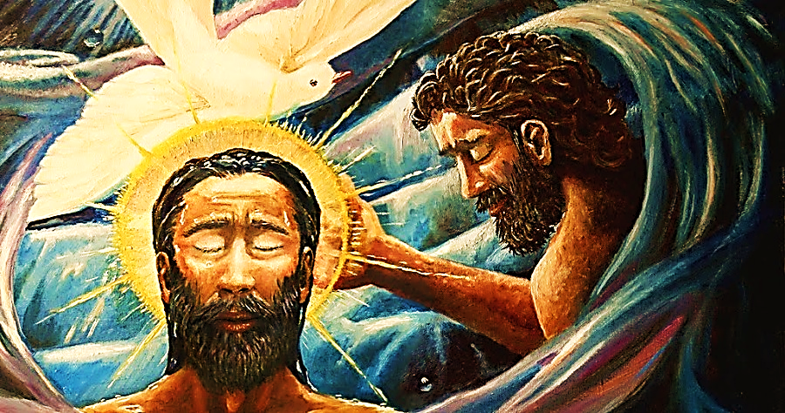
Jesus was both a natural man & an eternal being. Like us, He walked in obedience, listening to His Father’s directives.
“But Jesus answered, “I assure you that the Son can do nothing alone. He does only what he sees his Father doing. The Son does the same things that the Father does.” Jn. 5:19 (ERV)

Slide 21
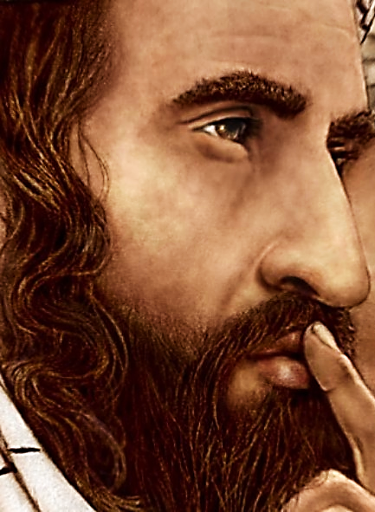
“I can do nothing alone. I judge only the way I am told…” Jn. 5:30 (ICB)
“But if I judge, I judge truthfully. When I judge, I am not alone. The Father who sent me is with me.”
Jn. 8:16 (ICB)

Slide 22
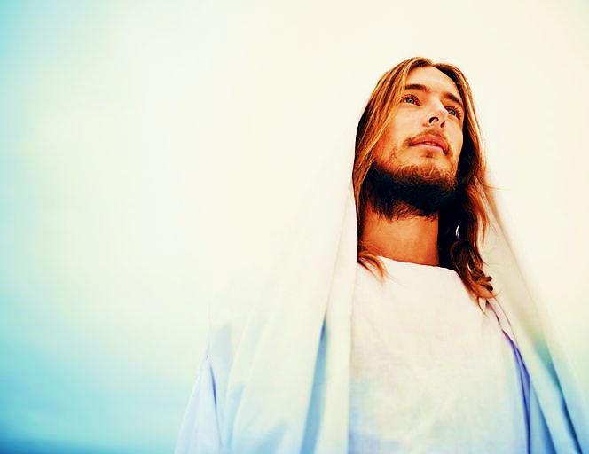
That is how Jesus navigated Earth… listening to the Father’s constant voice.
But now, for a moment, the Father was silent.

Slide 23
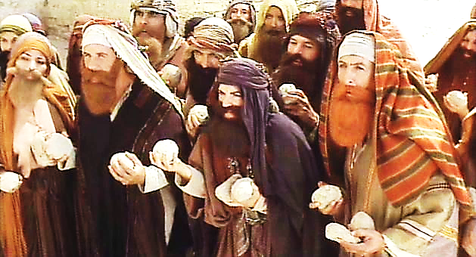
The Father had always rescued the Son.
“At that point the Jewish leaders picked up stones to kill him. But Jesus was hidden from them, and walked past them and left the Temple.” Jn. 8:59 (TLB)

Slide 24
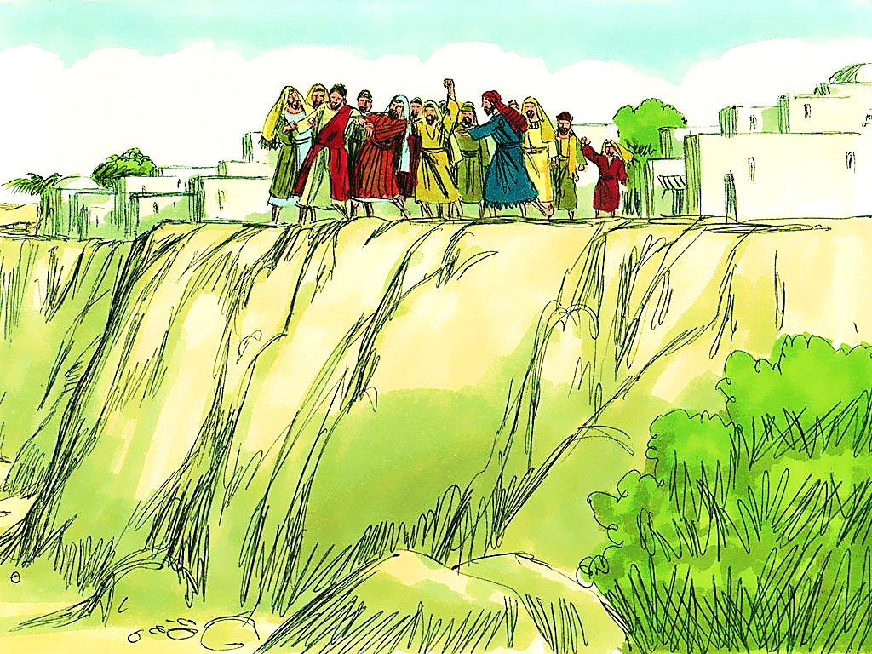
“They got up and forced Jesus to go out of town. Their town was built on a hill. They took Jesus to the edge of the hill to throw him off. But he walked through the middle of the crowd and went away.” Lk. 4:29, 30

Slide 25
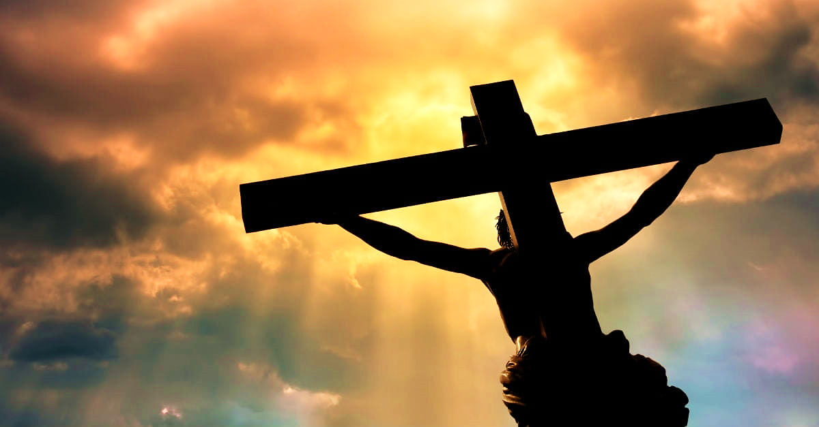
Now it was dark, the earth shook, the Father was silent and no rescue came.
Now Jesus is suffering what we often suffer. That “Where is God?” I’m all alone feeling.
Jesus missed the Father, His voice, His direction, the sense of His presence, and His timely interventions.

Slide 26
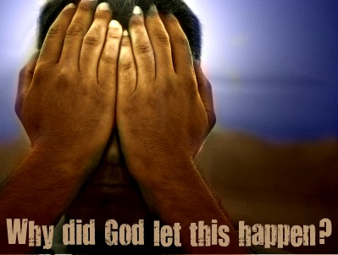
No intervention was coming.
Like the psalmist David before Him, Jesus was in a place of complete deprivation and blind faith.

Slide 27
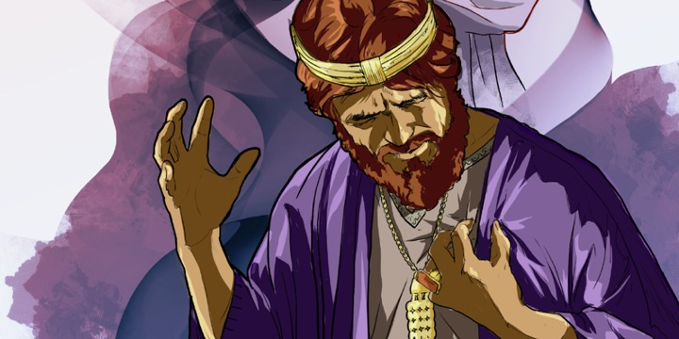
In prophetic spirit, David cries out:
“My God, my God, why have You forsaken me?
Why are You so far from saving me, so far from my words of groaning?” Ps. 22:1
But then, later in Psalm 22, David proclaims the blessing that would be born out of the pain:
“Everyone on this earth will remember you, Lord. People all over the world will turn and worship you,” Ps. 22:27 (CEV)

Slide 28

And, when we do suffer these confusing times of silence and seeming lack of intervention, God would say to us as He said to Israel…
“I abandoned you for one brief moment, but I will bring you back with unlimited compassion.” Isa. 54:7 (GW)

Slide 29

And, when we do suffer these confusing times of silence and seeming lack of intervention, God would say to us as He said to Israel…
Most of us can go hours, even days without seeking intimacy with the Lord.
When we do seek it, we often do so half-heartily, or just to say we did it.

Slide 30
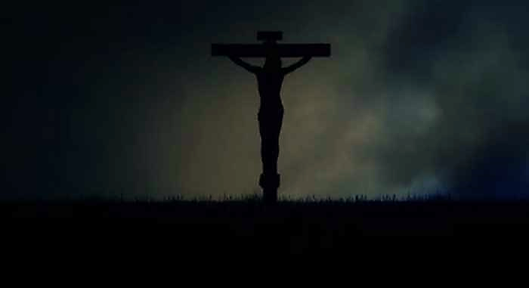
But, Jesus couldn’t stand a single moment out of deep communication with the Father. Even in the silence and in the darkness, He cries MY God, MY God.

Slide 31
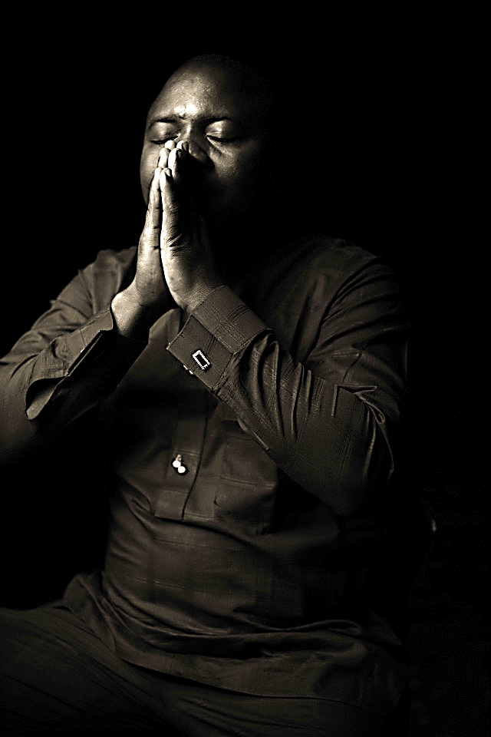
Even when we can’t see or hear or feel Him, let us remember to call MY God…not my brother’s God, or my mother’s God, but, MY God, My God.
Even in the silence, even in the darkness, even when the ground beneath us shakes, we are still His—ever His!

Slide 32
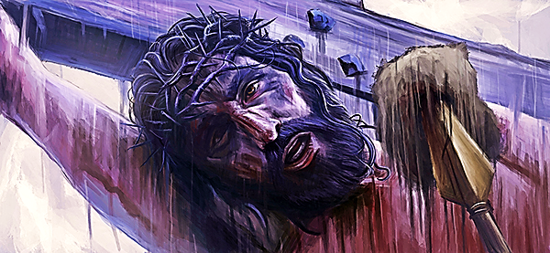


Slide 33
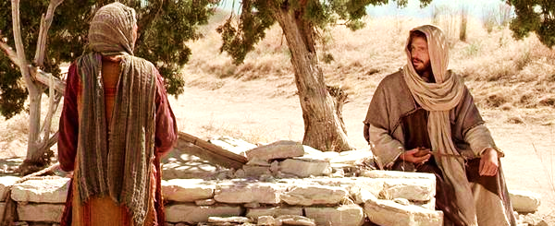
Jesus knew how it felt to be physically exhausted and thirsty:
“…Jesus, tired out by the trip, sat down by the well. It was about noon. A Samaritan woman came to draw some water, and Jesus said to her, ‘Give me a drink of water.’” Jn. 4:6, 7 (GNT)

Slide 34

Then Jesus explained spiritual thirst to her.
“…“If you only knew the gift God has for you and who you are speaking to, you would ask me, and I would give you living water.” Jn. 4:10 (NLT)
“…Anyone who drinks this
water will soon become
thirsty again. But those who
drink the water I give will
never be thirsty again. It becomes a fresh, bubbling spring within them, giving them eternal life.”
Jn. 4:13, 14 (NLT)

Slide 35
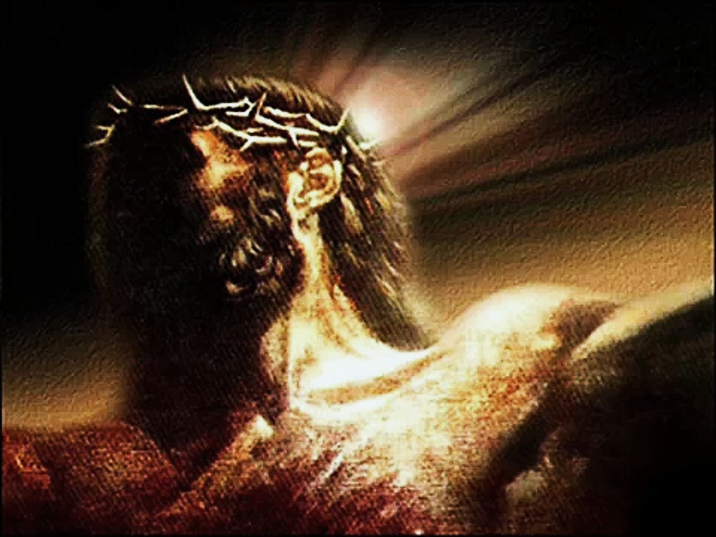
Somehow, in this short moment of darkness, Jesus (the essence of Living Water Himself) felt a deep dryness.
The horrors of the world’s sin (which he had become) and the fullness of God’s judgement for that sin, brought Him to a place of both physical (and even more excruciating) spiritual torment.

Slide 36
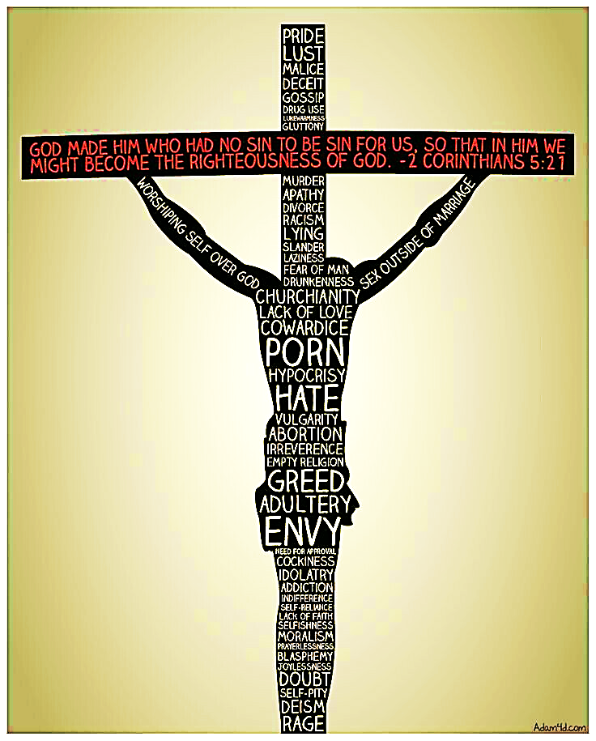
“Christ had no sin, but God made him become sin so that in Christ we could be right with God.” 2 Cor. 5:21 (ERV)
“…he carried away the sins of many…”
Isa. 53:12 (ERV)

Slide 37
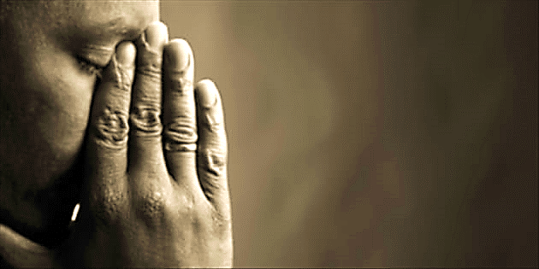
Jesus understands spiritual torment.
When God seems far away, when the way seems dark, even when sin robs us of a sense of life and connection with God, remember Jesus has tasted all this torment on the cross.

Slide 38
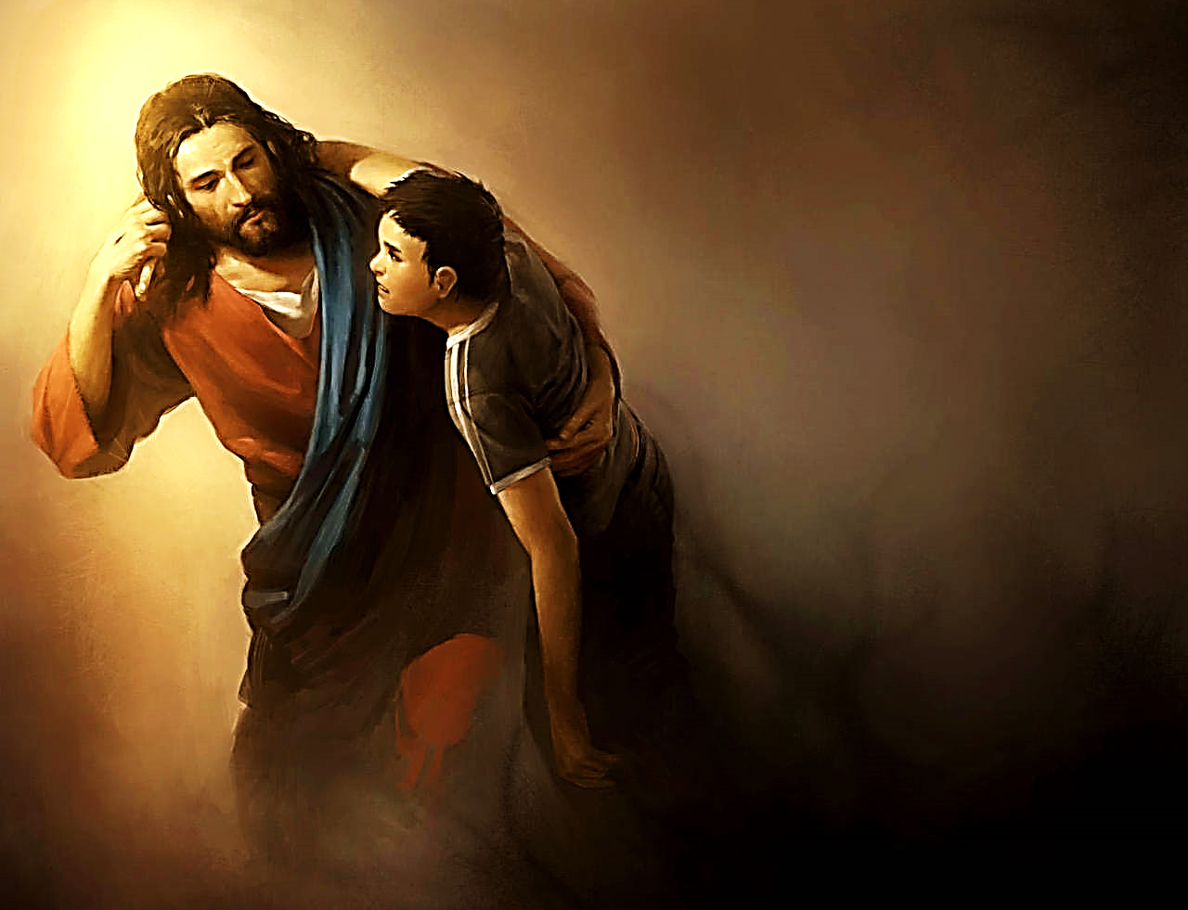
“So he had to be made like people, fully human in every way.
Then he could serve God as a kind and faithful high priest. And then he could pay for the sins of the people by dying for them…
He himself suffered when he was tempted. Now he is able to help others who are being tempted.” Heb. 2:17, 18 (NIRV)

Slide 39
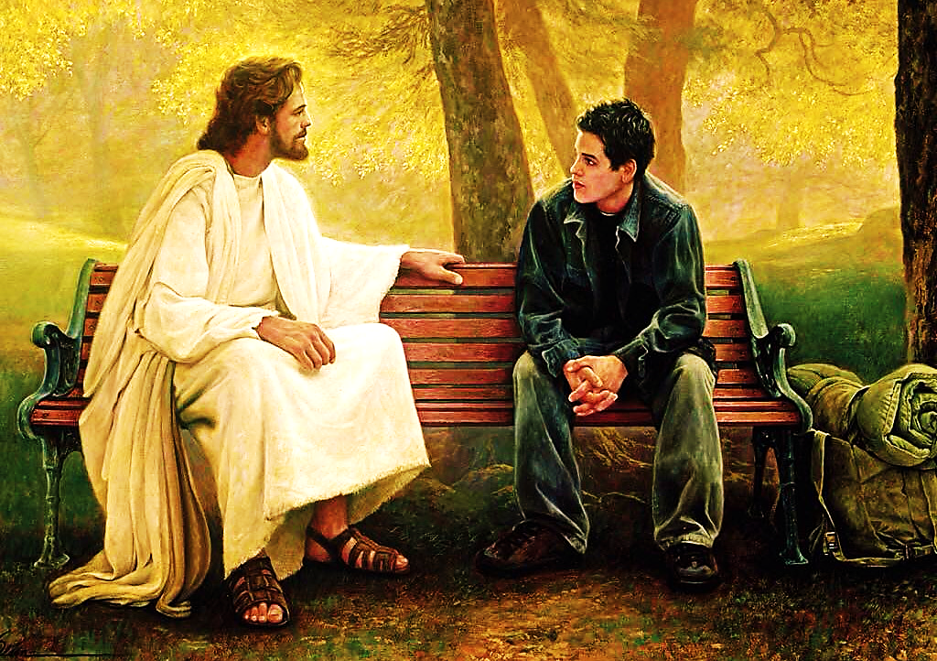
“And he is able to deal gently with ignorant and wayward people because he himself is subject to the same weaknesses.” Heb. 5:2

Slide 40

Truth #4) Jesus Determined to Finish His Mission

Slide 41
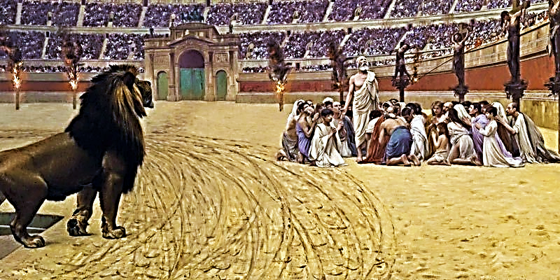
The reaching souls for Christ remains the most noble and difficult work on Earth. It brings rejection, persecution, self-sacrifice, time, effort and sometimes even death.

Slide 42
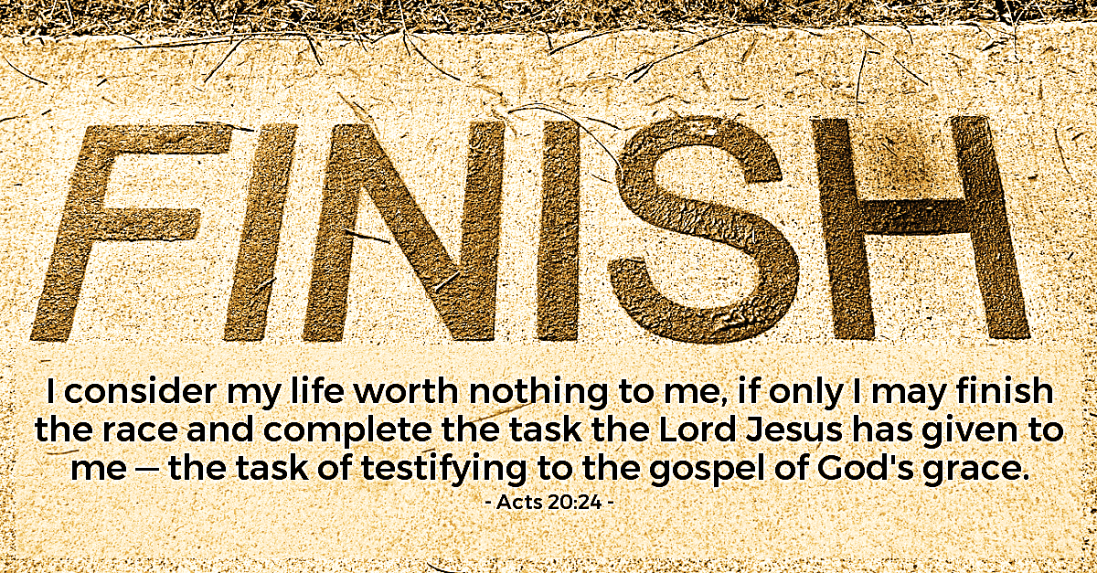

Slide 43

“But you be sober in all things, suffer hardship, do the work of an evangelist, and fulfill your ministry…
For I am already being offered, and the time of my departure has come. I have fought the good fight. I have finished the course. I have kept the faith.” 2 Tim. 4:5-7 (WEB)

Slide 44
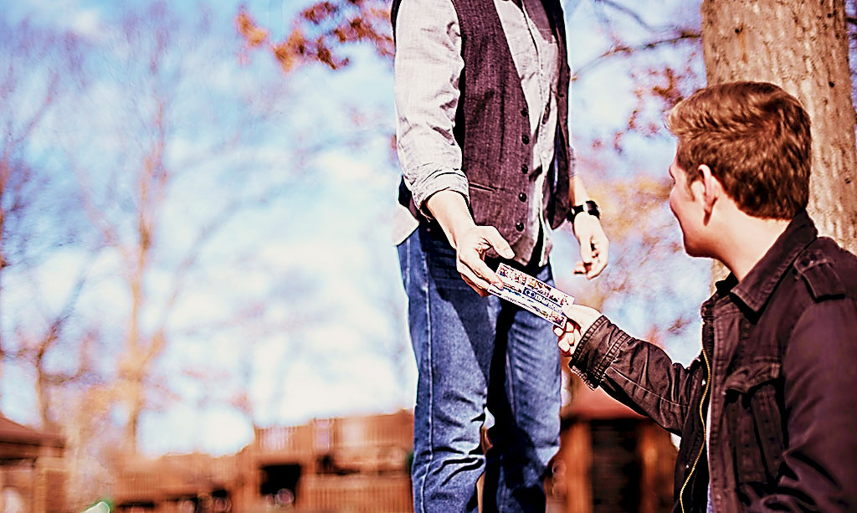
“And let us not grow weary of doing good, for in due season we will reap, if we do not give up.” Gal. 6:9 (ESV)
“Jesus explained, "My food is to do the will of Him who sent Me and to finish His work.” Jn. 4:34 (BEREAN)

Slide 45
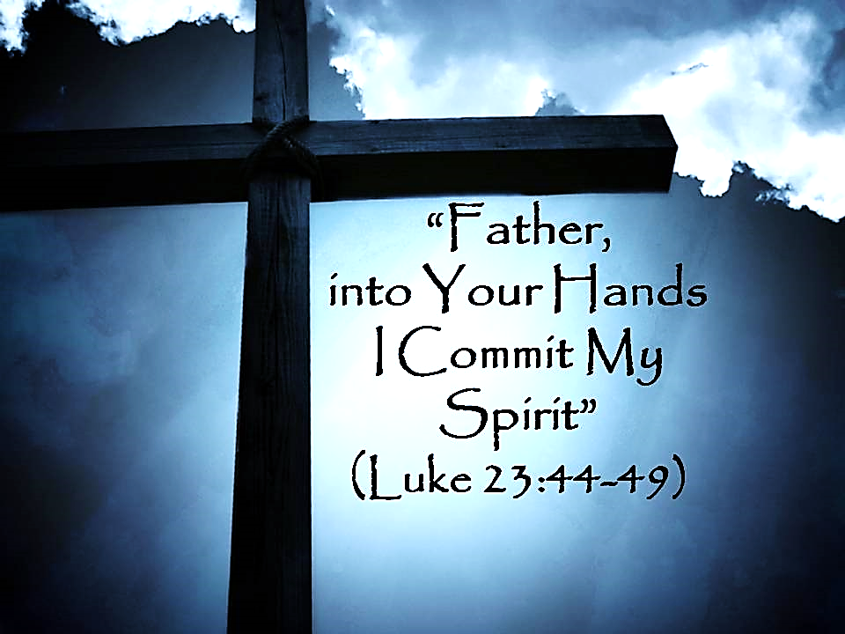
Truth # 5 - Jesus trusted God Completely.

Slide 46


Slide 47
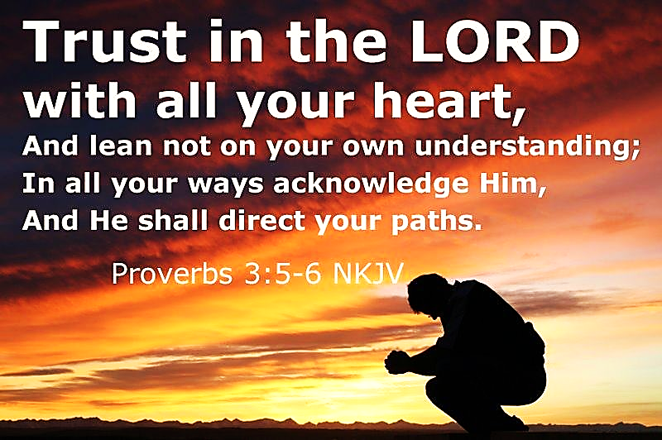

Slide 48
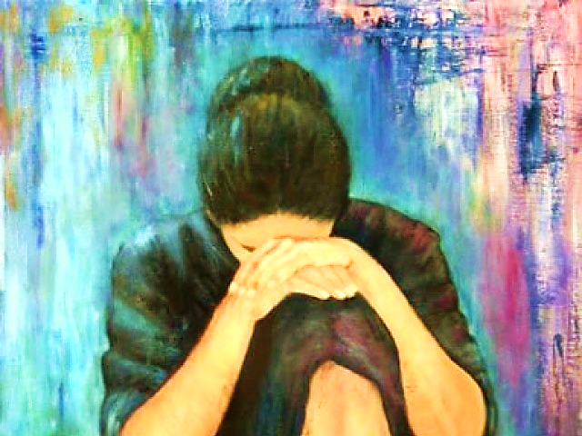
“Cast your burden on the Lord— he will support you! God will never let the righteous be shaken!”
Ps. 55:22 (CEB)
“Trust in God at all times, my people. Tell him all your troubles, for he is our refuge.”
Ps. 62:8 (GNT)

Slide 49
Truth #1 - With a great burden for souls
Father forgive them
Today you will be with me
Truth #2 - Honoring our responsibilities
Behold your mother / your son

Slide 50
Truth #3 - Yearning for nearness to God
My God, My God
I Thirst
Truth #4 - Determined to finish our mission
It is Finished

Slide 51
And Finally…
#5 -Trusting God completely
Into thy hands I commit my spirit

Slide 52
Song: Oh God, You Are My God
Video Goes Here
Title: Oh God, You Are My God
Download Here:
https://youtu.be/vGm7ivZcW_w

Slide 53
Song: Hunger
Video Goes Here
Title: Hunger
Download Here:
https://youtu.be/rxnmZHyMteg

Slide 54
Note: After you download the slideshow, you may also need to download some videos from YouTube & add them into this PowerPoint. This tool can help you:
Free YouTube Download
We present these messages in outdoor venues using the SonShineTent.
Watch the video of our service that goes with this message, click here: http://campaignkerusso.org/?p=16326
We would love to know more about the people who download our lessons & sermons. We invite you to email us & let us know where & how you use them.
info@campaignkerusso.org

Slide 55
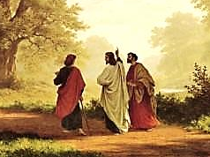
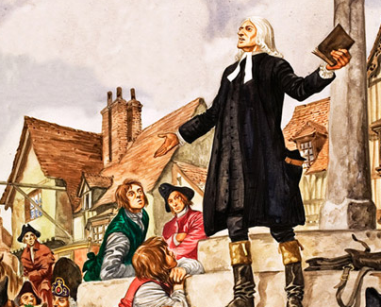
Is Jesus
Speaking to You?
“They said to each other, ‘Did not our hearts burn within us while he talked to us on the road, while he opened to us the Scriptures?’”
John Wesley Said:
“…the preacher was describing the change which God works in the heart through faith in Christ and I felt my heart strangely warmed.”
Jesus makes His presence Known by a small voice!

Slide 56
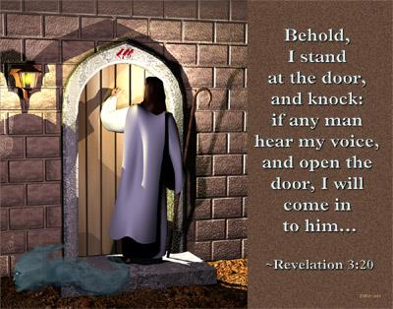

Slide 57
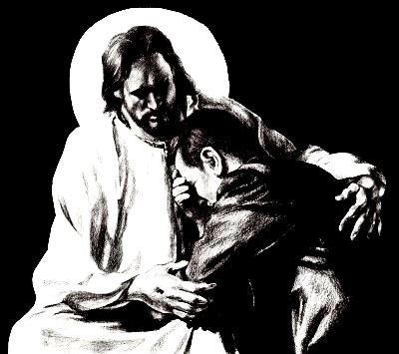
What is the Sinner‘s Prayer?
This is a prayer we can pray when we are ready to admit we are sinners and need Christ’s forgiveness.
It must be prayed with faith in our hearts and a readiness to have a life-changing encounter with Jesus Christ.

Slide 58

A prayer of faith → Pray this prayer if :
If you never have before
You have in the past, but you think it would mean more today
You have been walking afar off and you want to come back
You want to set an example & show others how it is done
You just like to give your heart to Jesus again & again
Faith

Slide 59
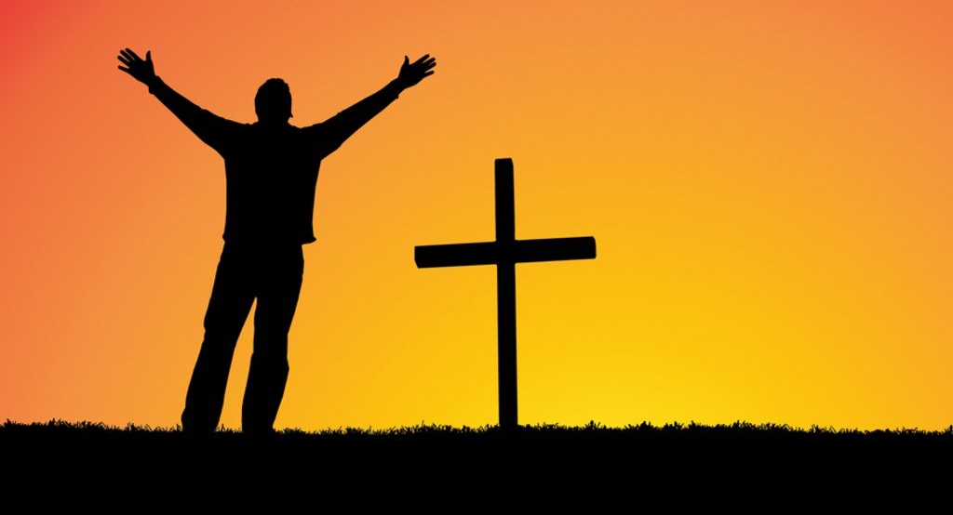
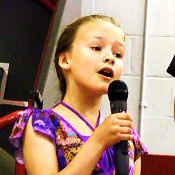
We Declare Our Faith Publicly Because
Jesus Declared His LOVE Publicly
“If you stand before others and are willing to say you believe in me, then I will tell my Father in heaven that you belong to me.” Mat 10:32
If you are ready to give your heart & life to Jesus right now, please come to the front as we pray this prayer together.

Slide 60

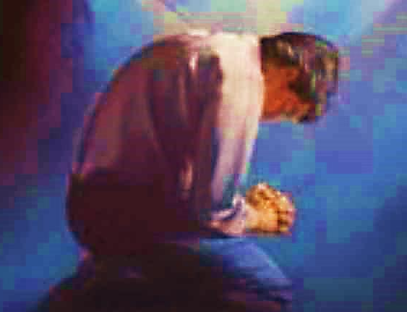
Three Important Questions
Do you want to know Jesus as your Savior right now?
Do you believe He died to save you from your sins & that He rose from the dead?
Do you believe that He is here, waiting to save you right now?

Slide 61
The Prayer of a Sinner Turning to Jesus
Dear Jesus, I know that I have sinned against You and that my sins separate me from You.
I am truly sorry.
Right now, I turn away from my sinful past .
Please forgive me, and help me to keep from sin.
I believe You died for my sins.
I Believe You rose from the dead, you are alive, and you hear this prayer from my heart.
I invite You Jesus to be both my Savior and the Lord of my life.
I want You to rule my life from now on.

Slide 62


“But some people did accept him. They believed in him, and he gave them the right to become children of God.”
John 1:12

Slide 63



Slide 64

Need a Volunteer (Kid or Adult) To:
Answer Lesson Questions

Slide 65


“If you openly say, ‘Jesus is Lord’ and believe in your heart that God raised him from death, you will be saved.”
Rom. 10:9
What did you learn today?
What about how we should live?
What have you been thinking about God lately?
What do you want to tell others about Jesus?

Slide 66
Song: Hunger
Video Goes Here
Title: Hunger
Download Here:
https://youtu.be/rxnmZHyMteg

Slide 67
Need a Volunteer (Kid or Adult) To:
Answer Lesson Questions
Explain the Gospel in a Nutshell Craft

Slide 68
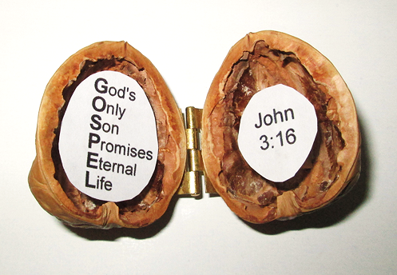
The Gospel
In a Nutshell

Slide 69
Need a Volunteer (Kid or Adult) To:
Answer Lesson Questions
Explain the Gospel in a Nutshell Craft
Explain the Big E-Cube

Slide 70
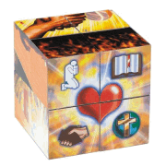
Evangecube
ss

Slide 71
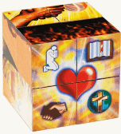
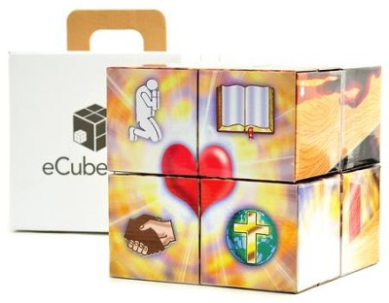
Evangecube
Buy a standard-sized EvangeCube here: EvangeCube
Buy a large sized EvangeCube here: Evangecube Big Cube

Slide 72
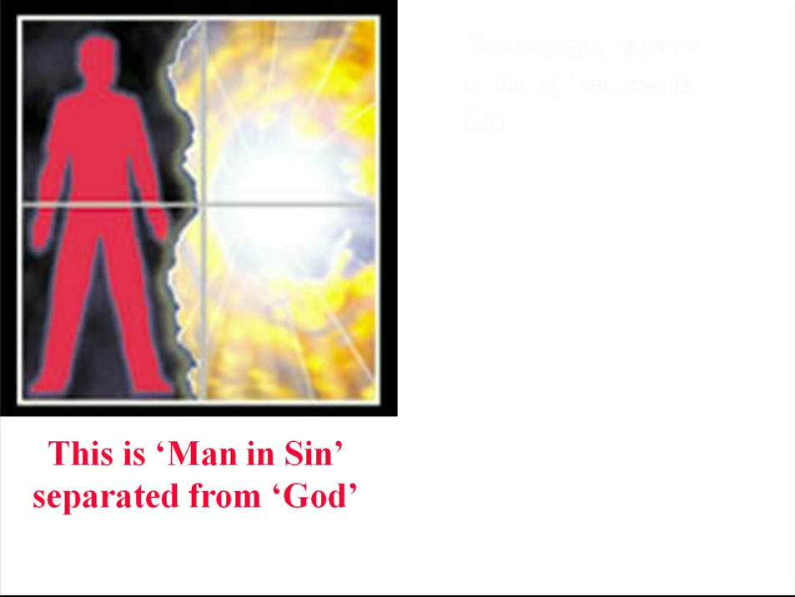

Slide 73
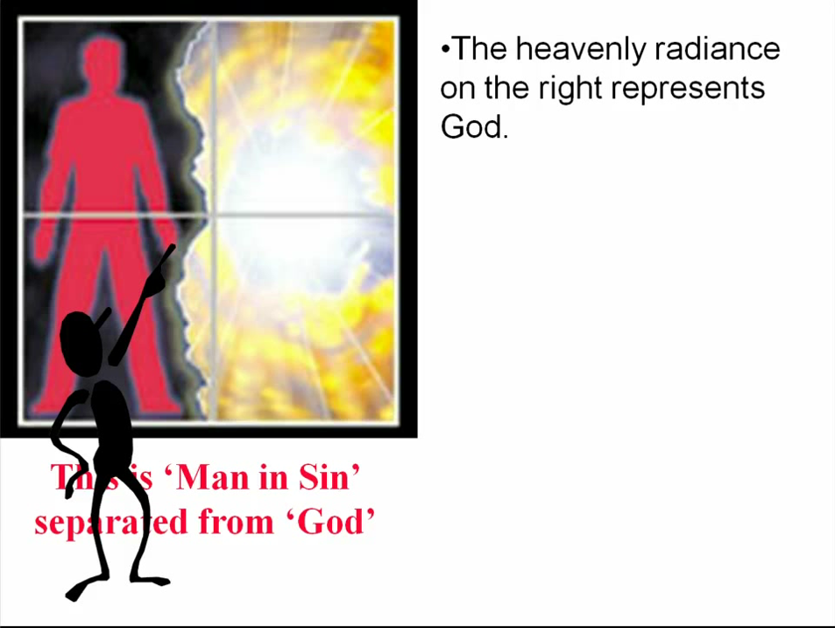

Slide 74
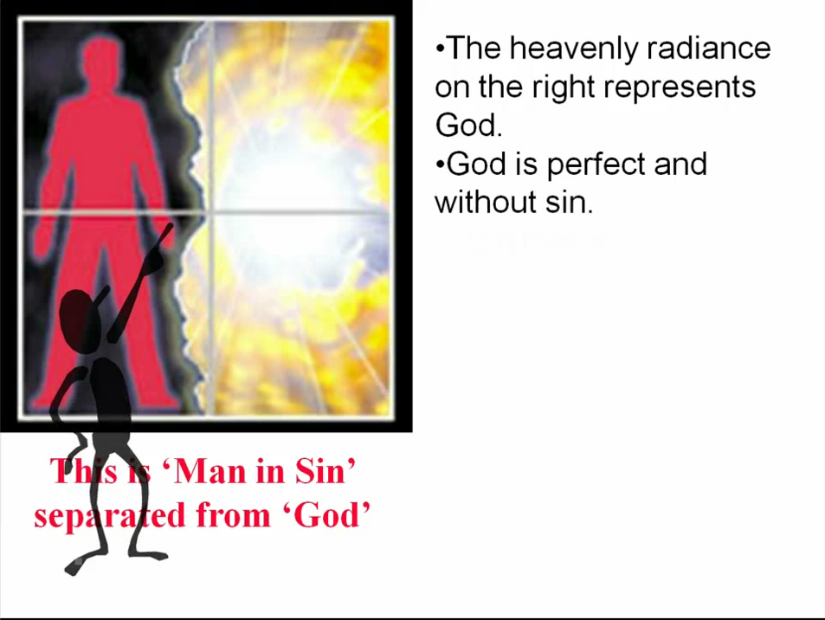

Slide 75


Slide 76


Slide 77


Slide 78


Slide 79


Slide 80


Slide 81


Slide 82


Slide 83


Slide 84


Slide 85


Slide 86


Slide 87


Slide 88


Slide 89


Slide 90


Slide 91


Slide 92


Slide 93


Slide 94


Slide 95


Slide 96


Slide 97


Slide 98


Slide 99
Need a Volunteer (Kid or Adult) To:
Answer Lesson Questions
Explain the Gospel in a Nutshell Craft
Explain the Big E-Cube
Explain the “Gospel in My Hand”

Slide 100

a
The Gospel
in
My
Hand

Slide 101
a
My Pointer:
Points to my sin. I don’t deserve Heaven.
My Thumb:
Like a hitchhiker, I need a free ride to Heaven.
My Longest Finger:
Reminds me of God. The greatest person in the universe.
My Ring Finger:
Reminds me of Jesus who loves me forever. He died to pay for my sin.
My Pinkie Finger:
It only take a little faith in Jesus (mustard seed size)
to give Him my heart and
my whole life.

Slide 102
This Coupon is Good for One
Free Prize at The SonShineTent
Give away 3 of these coupons to 3 different children. Then bring back the plastic bag for another prize for you.

Slide 103

A small gift from us to you at the hospitality table.
Thank
you for coming.

Slide 104

Let’s Close in Prayer

Slide 105
Note: After you download the slideshow, you may also need to download some videos from YouTube & add them into this PowerPoint. This tool can help you:
Free YouTube Download
We present these messages in outdoor venues using the SonShineTent.
Watch the video of our service that goes with this message, click here: http://campaignkerusso.org/?p=16326
We would love to know more about the people who download our lessons & sermons. We invite you to email us & let us know where & how you use them.
info@campaignkerusso.org

